Slide 1
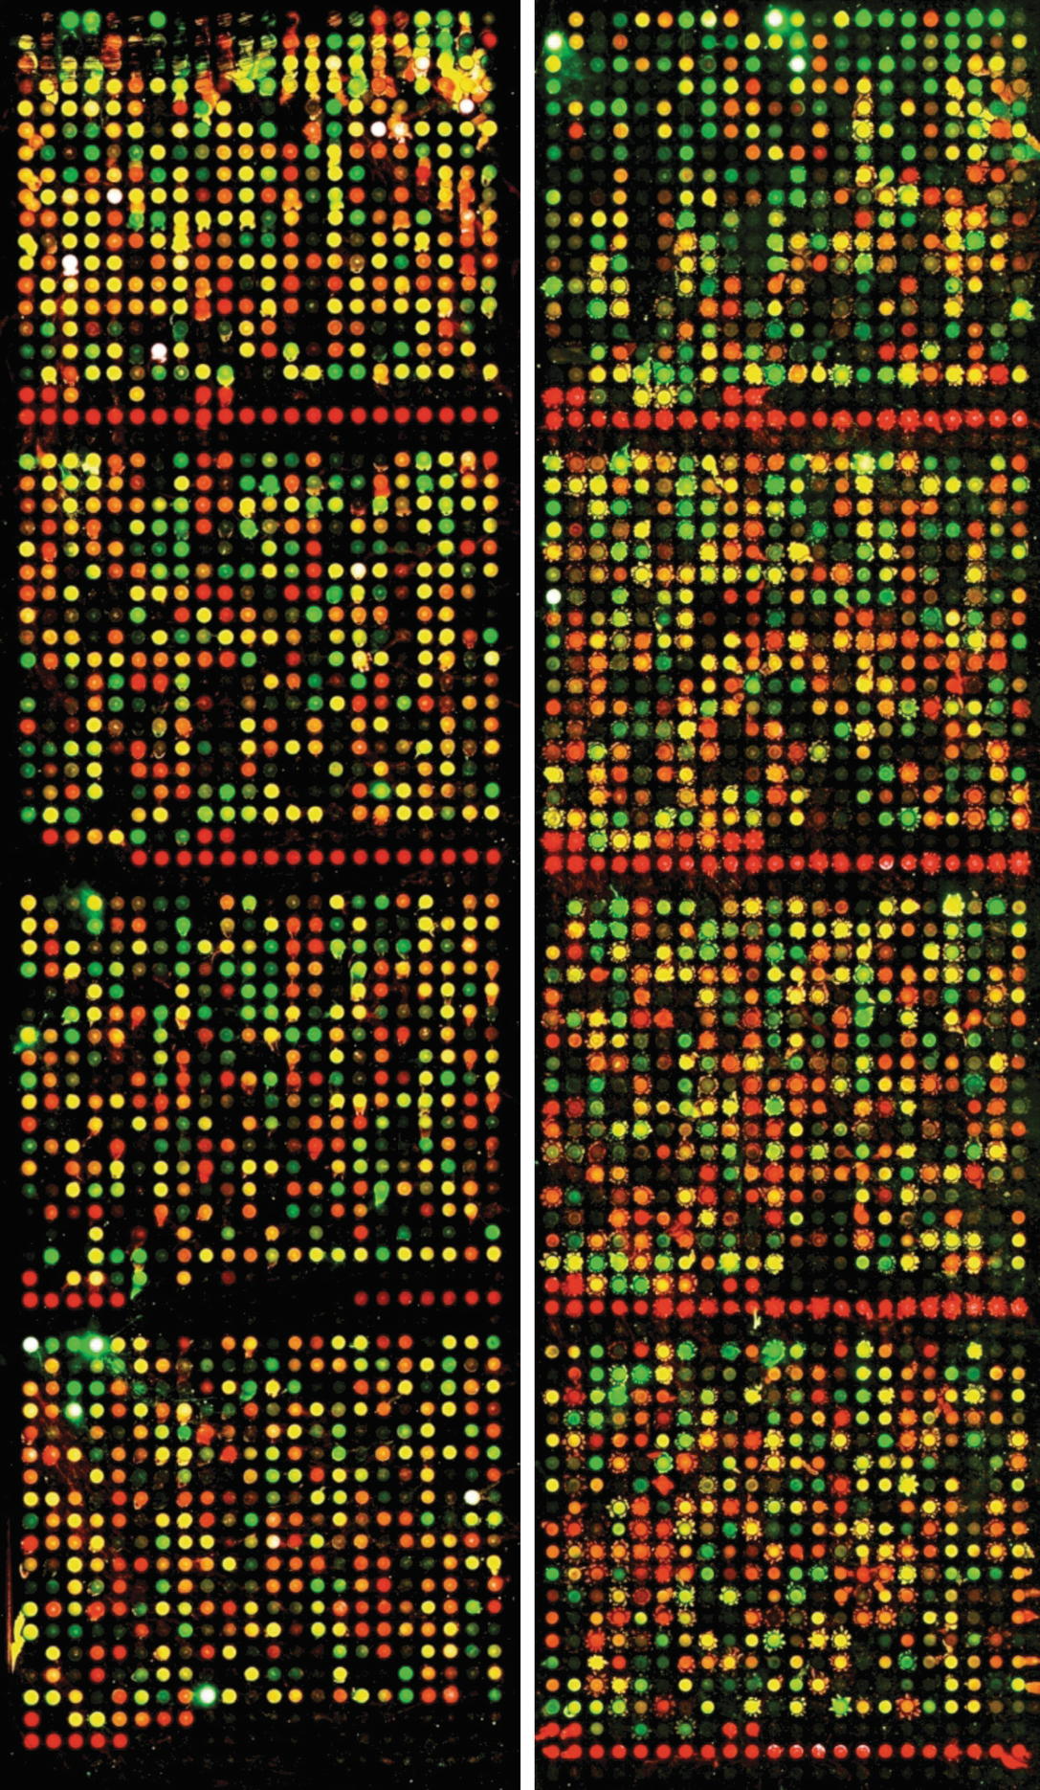
FINAL PRESENTATION
The role of tissue-restricted antigens (TRAs) in the early embryonic development
Alewtina Towara, Clara Certa, Linda Kaupp, Yaxin Chen
Supervisor: Dr. Maria Dinkelacker
Tutor: Ian Dirk Fichtner

Slide 2
Agenda
Recapitulation
Results
Discussion Hypothesis and milestones Team and tasks

Slide 3
Recapitulation
Notes:
Yaxin

Slide 4
Our main objective
Identify differentially expressed genes in early embryogenesis and compare them with TRA dataset to determine tissue development.

Slide 5
Hypothesis
Investigate differential expression of TRAs in dataset
Which genes are differentially expressed?
What is the biological function ?
Investigate differential expression of Chemokines and their receptors
What is the biological function?
Test for correlation between Chemokine(receptor) expression and expression of downstream pathway proteins

Slide 6
Results

Slide 7
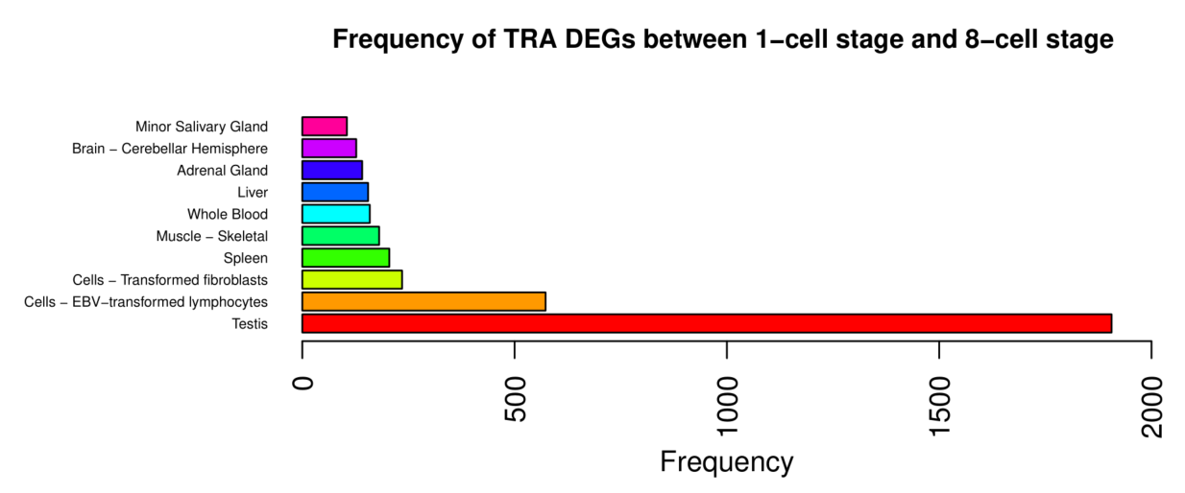
TRAs in our data set
→There are TRAs present in the early embryonic development

Slide 8
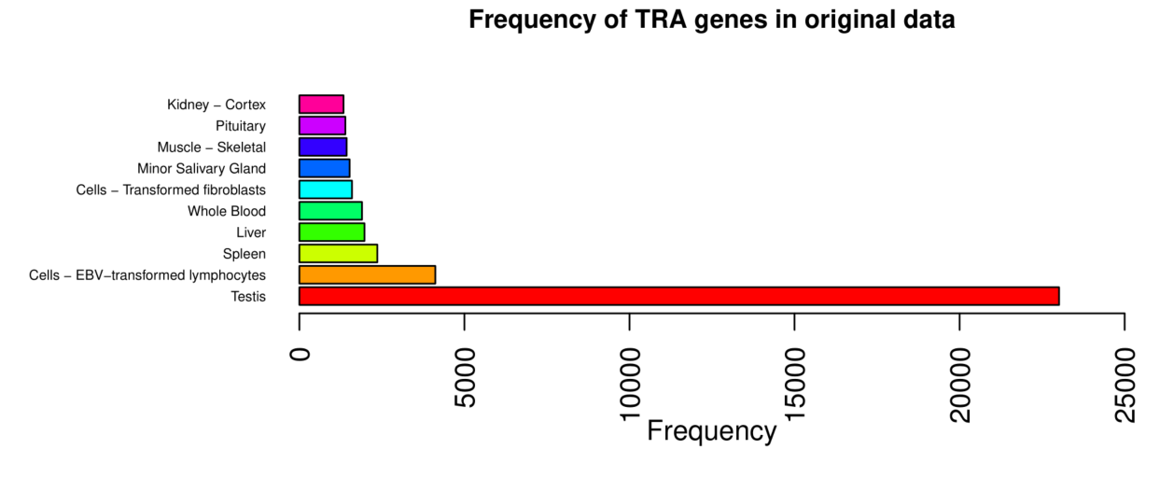
Tissue distribution in TRA data
→Overrepresented testis genes

Slide 9
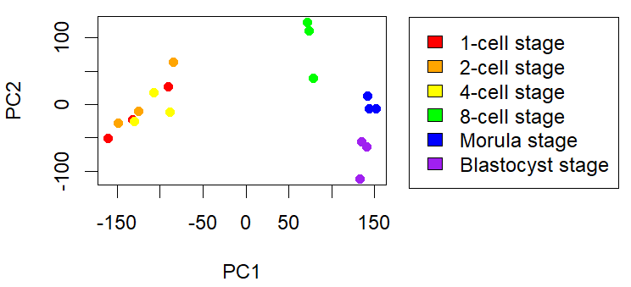
PCA and kmeans
→ Focus on difference between stages 1 cell-4 cell, 8 cell, morula and blastocyst

Slide 10
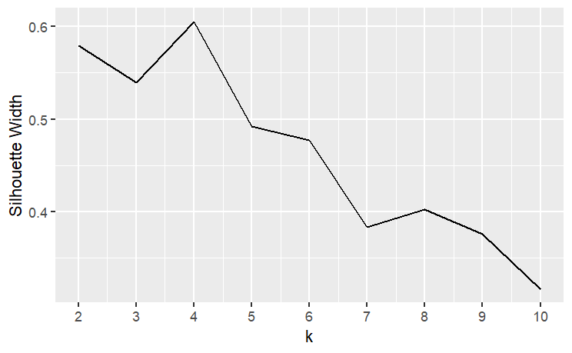
PCA and kmeans
→ Focus on difference between stages 1 cell-4 cell, 8 cell, morula and blastocyst

Slide 11
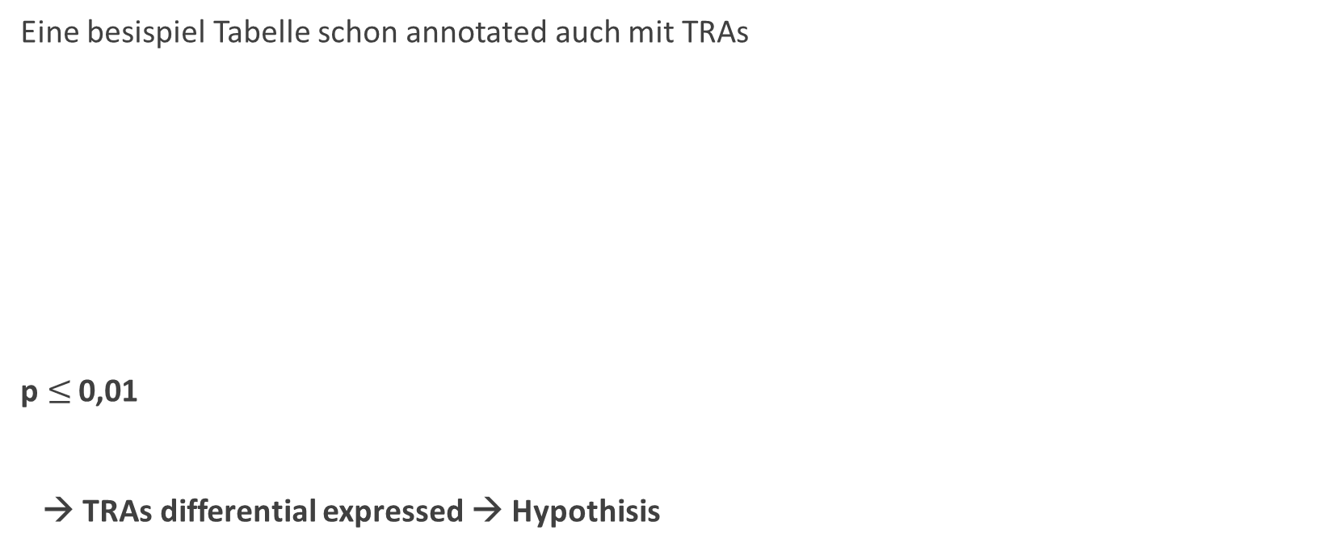
Differential expression: Limma
Eine besispiel Tabelle schon annotated auch mit TRAs
p$≤$ 0,01
→ TRAs differential expressed → Hypothisis

Slide 12
Differential expression: Volcano-plot
3 Volcano-plots

Slide 13
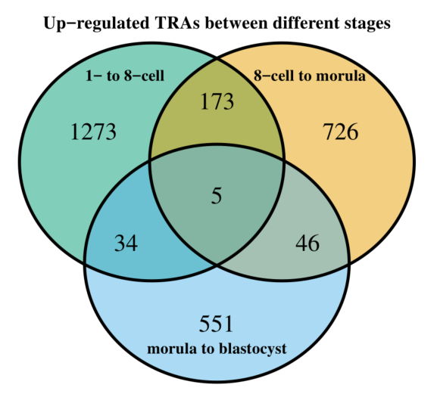
Venn-diagram
→ differential expressed TRAs in all focused stage transitions

Slide 14
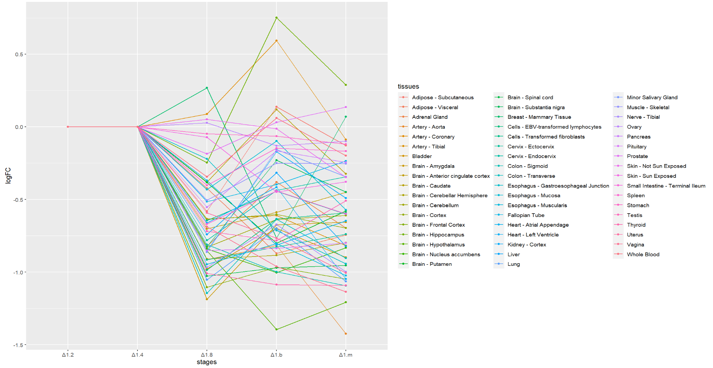
logFC average in specific tissues
→ X tissues increase continuously
→ Y tissues display most variety

Slide 15
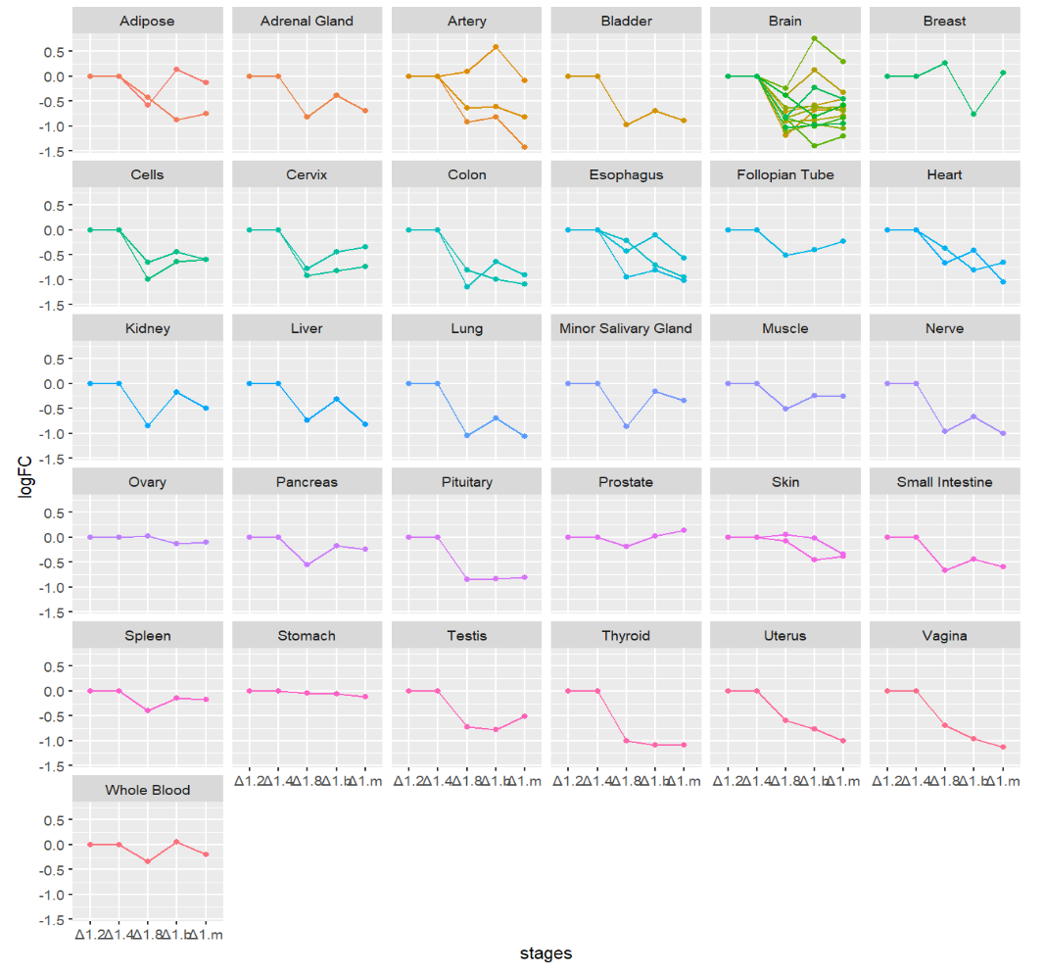
Facetting
→ X tissues increase continuously
→ Y tissues display most variety

Slide 16
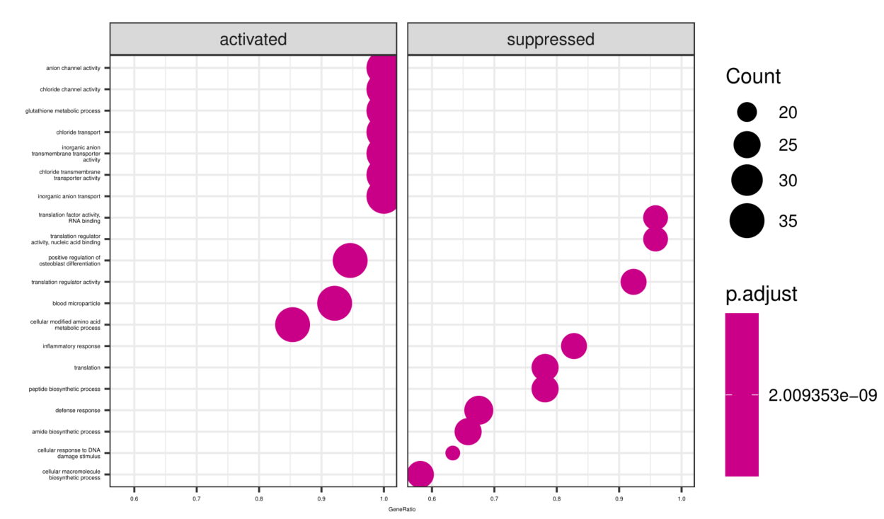
Set enrichment analysis
→ pathways upregulated

Slide 18
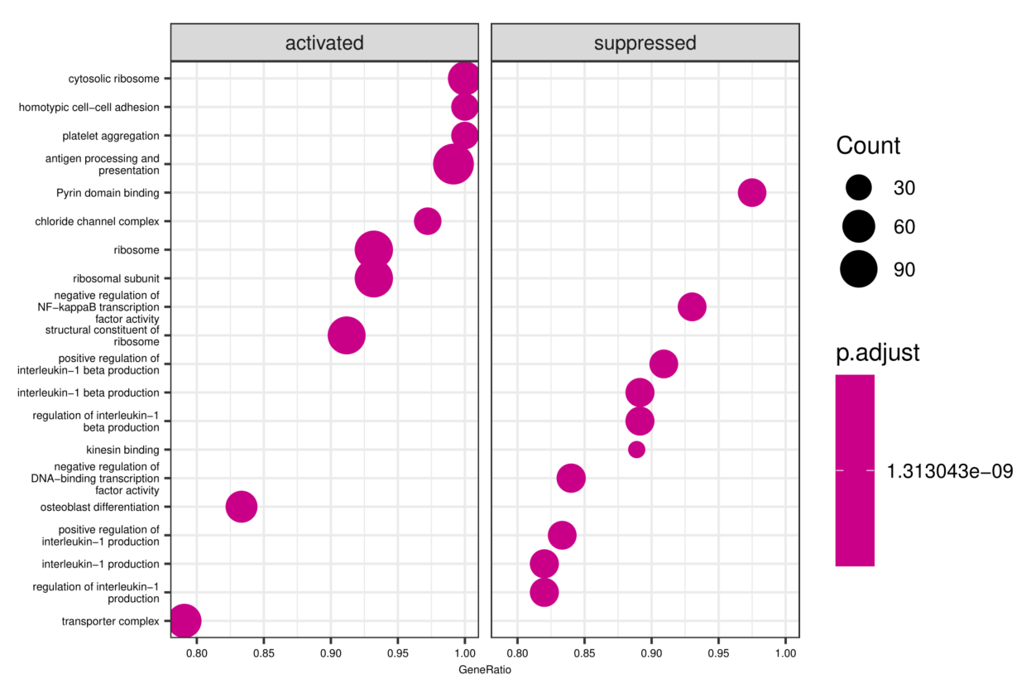

Slide 19
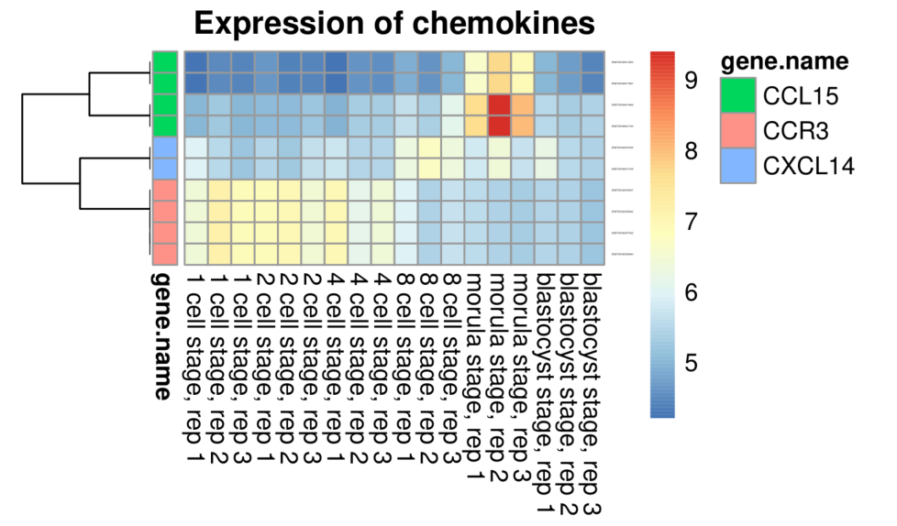
Chemokine analysis

Slide 20
Discussion
Notes:
Alewtina

Slide 21


Notes:
Clara

Slide 22
Literature
Dinkelacker 2019. Chromosomal clustering of tissue restricted antigens, Dissertation, University Heidelberg, Germany.
Dinkelacker 2007. A database of genes that are expressed in a tissue-restricted manner to analyse promiscous gene expression in medullary thymic epithelial cells. Diplomarbeit, Albert-Ludwigs-Universität, Freiburg, Germany.
Xie D, Chen CC, Ptaszek LM, Xiao S, Cao X, Fang F, Ng HH, Lewin HA, Cowan C, Zhong S. Rewirable gene regulatory networks in the preimplantation embryonic development of three mammalian species. Genome Res. 2010 Jun;20(6):804-15. doi: 10.1101/gr.100594.109. Epub 2010 Mar 10. PMID: 20219939; PMCID: PMC2877577.
Li H, Meng YH, Shang WQ, Liu LB, Chen X, Yuan MM, Jin LP, Li MQ, Li DJ. Chemokine CCL24 promotes the growth and invasiveness of trophoblasts through ERK1/2 and PI3K signaling pathways in human early pregnancy. Reproduction. 2015 Nov;150(5):417-27. doi: 10.1530/REP-15-0119. Epub 2015 Aug 27. PMID: 26316550.
https://www.drgururpolat.com/de/in-vitro-fertilisation/entwicklung-vom-embryo/
https://www.ncbi.nlm.nih.gov/geo/query/acc.cgi?acc=GSE18290

